Slide 1
Neural Networks

Slide 2
Neural Networks
It is a computer system on the human brains and nerves system.
NN use artificial intelligence to untangle and break down extremely complex relationships.

Slide 3
Neural Networks
Artificial neural network, is an interconnected group of neurons in neural artificial networks that uses a mathematical or computational model for information processing based on a connection approach to computation.

Slide 4
Neural Networks
Neural Networks consists 3 layers
Input Layer
Hidden Layer
Output Layer

Slide 5
Neural Networks
Input Layer
The purpose of the input layer is to receive as input the values of the explanatory attributes for each observation.
‘input layer’ presents the patterns to the network, which communicates to one or more ‘hidden layers’.
The nodes of the input layer are passive, meaning they do not change the data. They receive a single value on their input and duplicate the value to their many outputs.
From the input layer, it duplicates each value and sent to all the hidden nodes.

Slide 6
Neural Networks
Hidden Layer
The Hidden layers apply given transformations to the input values inside the network. There may be one or more hidden layers.
It connects with outgoing arcs to output nodes or to other hidden nodes. In a hidden layer, the actual processing is done via a system of weighted ‘connections’.
The values entering a hidden node multiplied by weights, a set of predetermined numbers stored in the program. The weighted inputs are then added to produce a single number.

Slide 7
Neural Networks
Output Layer
The hidden layers then link to an ‘output layer‘. Output layer receives connections from hidden layers.
It returns an output value that corresponds to the prediction of the response variable.
In classification problems, there is usually only one output node.

Slide 8
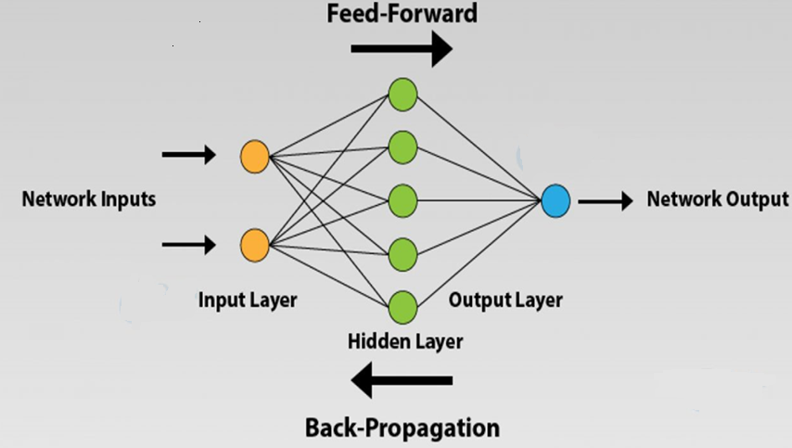
Neural Networks -ANN

Slide 9
Neural Networks -ANN

Slide 10
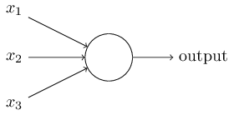
Neural Networks -ANN
Working Procedure
A perceptron takes several binary inputs, x1,x2,…, and produces a single binary output.
Weights w1,w2, W3…, real numbers expressing the importance of the respective inputs to the output. The neuron's output, 0 or 1, is determined by whether the weighted sum ∑jwjxj is less than or greater than some threshold value. z

Slide 11
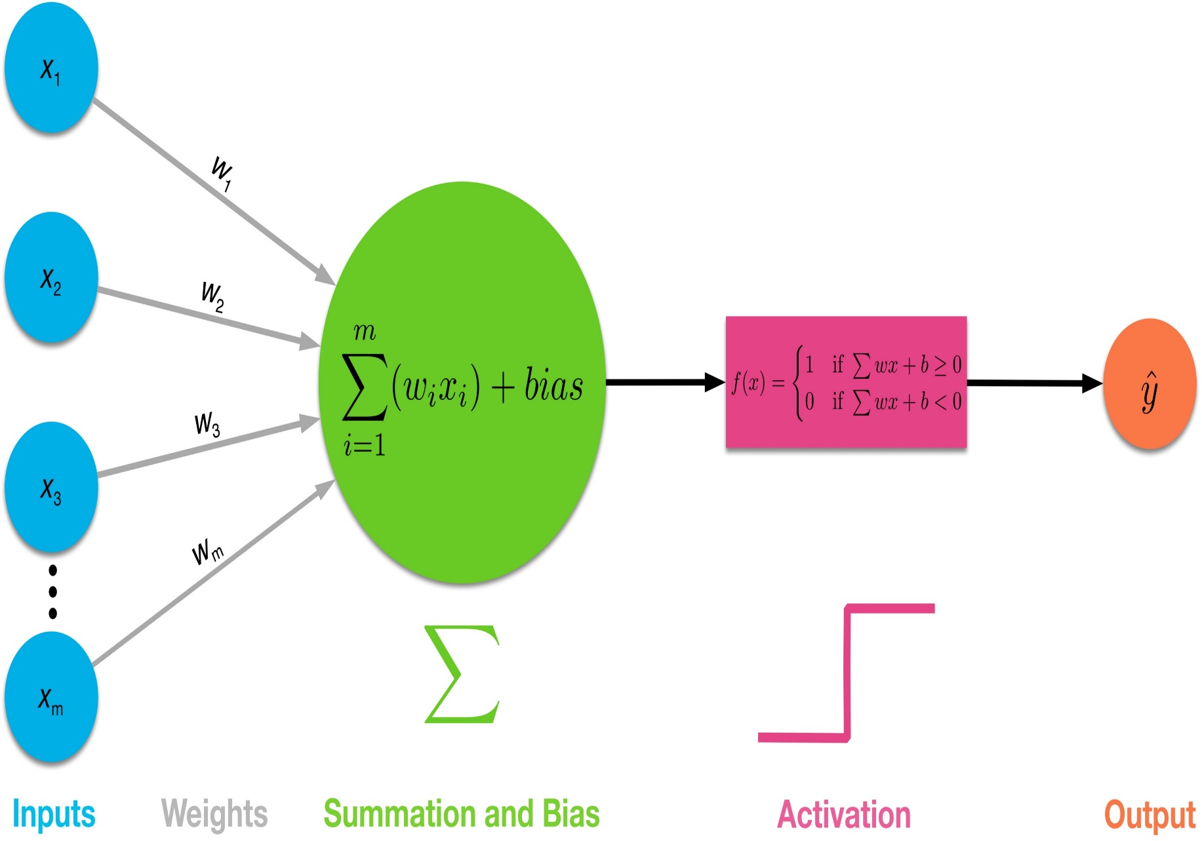
Neural Networks -ANN

Slide 12
Neural Networks -ANN
Activation function
Activation function determines the output of a neural network model.
Activation function decides, whether a neuron should be activated or not by calculating weighted sum and further adding bias with it. The purpose of the activation function is to introduce non-linearity into the output of a neuron.

Slide 13

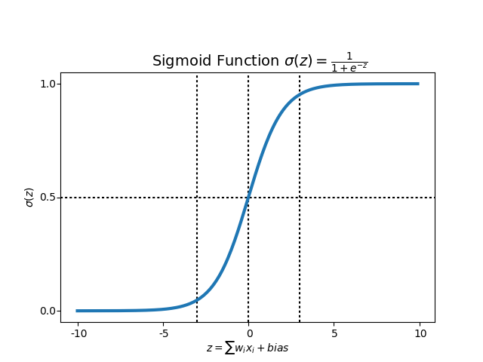
Neural Networks -ANN
Sigmoid Activation Function

Slide 14
Neural Networks -ANN
The threshold is a real number which is a parameter of the neuron.
To put it in more precise algebraic terms:
output= 0 if ∑jwjxj ≤ threshold
1 if ∑jwjxj > threshold

Slide 15
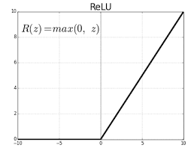
Neural Networks -ANN
ReLU (Rectified Linear Unit) Activation Function
The ReLU is half rectified (from bottom).
f(z) is zero when z is less than zero
f(z) is equal to z when z is above or equal to zero.

